Slide 1

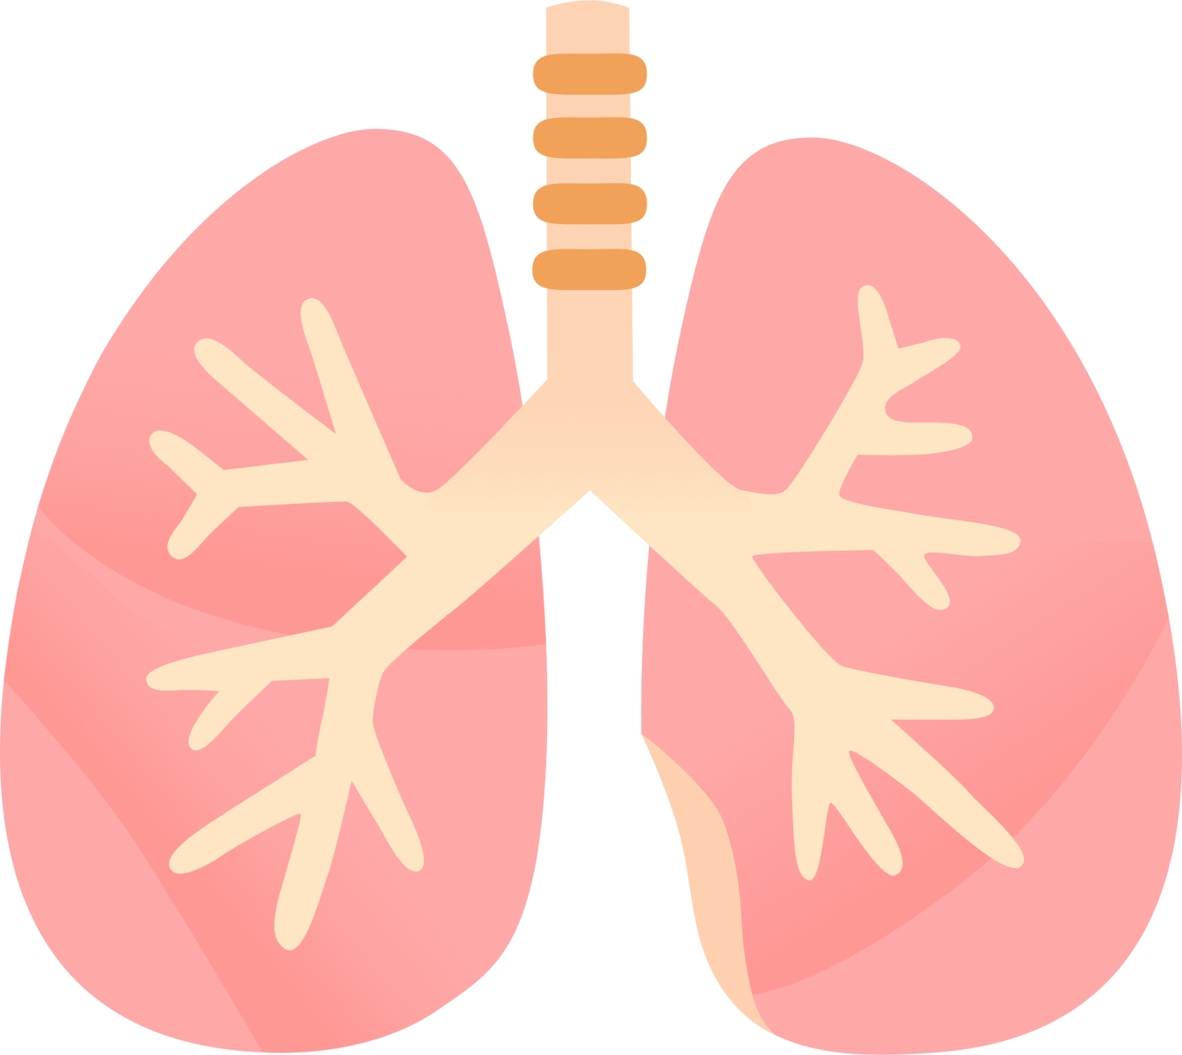
LUNG SOUND RECORDER
Team: Quad-Core Squad
By: Karthik, Aryanil, Anurag, and Adithya
Professor: Abhishek Srivastava
TA: Santhoshini
Week-8

Slide 2
Improving the application

Slide 3
This week
Worked a bit on the backend of the website
Improved the label mapping
Added better labels (instead of numbers/ letters)
The demo of the website can be found at the official project repo: https://github.com/AryanilPanja/lung_sound_recorder

Slide 4
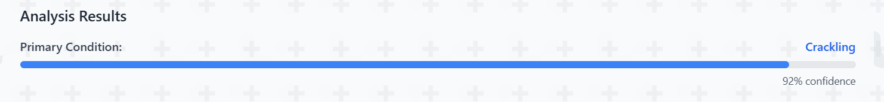
Output
The website now outputs the predicted condition with a proper label along with the rounded confidence score of the prediction

Slide 5
Modified filtering
Modified the filters to get lung sounds
Changed the low-pass and high-pass cutoffs for the bandpass filter
Lung sounds generally appear in the 100-1000 Hz range
Slight overlap with heart sounds

Slide 6
Pipelining

Slide 7
Recording Pipeline
Pipelined the entire recording process
Now the recording of the sound and uploading of the file happen simultaneously
Code can be found at https://github.com/AryanilPanja/lung_sound_recorder/blob/main/ESP_codes/combined_mic_server.ino

Slide 8
Filtering Pipeline
Pipelined the filtering process
Now the python code automatically fetches the recorded file from the hosted web server
The fetched file is then filtered and saved
Code can be found at https://github.com/AryanilPanja/lung_sound_recorder/blob/main/filtered_algo/all3_pipe.py

Slide 9
Next Steps
Final Integration from the recording to the website output.
Improvement of quality of lung sound recording from the stethoscope.

